Slide 1
Understanding Culture, Understanding Students: International Student Experiences in an Uncertain World
Meri Linn McCollum, Assistant Professor of Education
Muskingum University

Slide 2
What is Culture?
A community or population sufficiently large enough to be self-sustaining
Totality of that group’s thoughts, experiences, and patterns of behavior, concepts, values, and assumptions about life that guide behavior
Culture regulates human life and identity
  Provides diverse ways of interpreting the environment and the world
  We see things through our own unique cultural lens
Culture is not a genetic trait
  The transmission of these thoughts and behaviors from birth over the course of generations
  Culture is shared and can be learned
  Group membership identification (cultural identity) = identification with and perceived acceptance into a group that has a shared system of symbols and meanings as well as norms for conduct

Slide 3
The Iceberg Principle
Culture can be viewed as an iceberg with elements that exist both above (visible) and below (invisible) the surface.
Facial expressions | Gestures | Paintings | Values
Holiday customs | Food | Concept of beauty | Eating habits
Music | Concept of fairness | Child raising beliefs | View of natural world
Religious beliefs | Concept of time | Concept of self | Concept of leadership
Literature | Nature of friendship | General world view | Work ethic
Rules of social etiquette | Concept of personal space | Clothing | Notion of modesty
Religious rituals | Rules of politeness | Tipping customs | Greetings
Views on equality | Attitudes toward sexuality

Slide 4
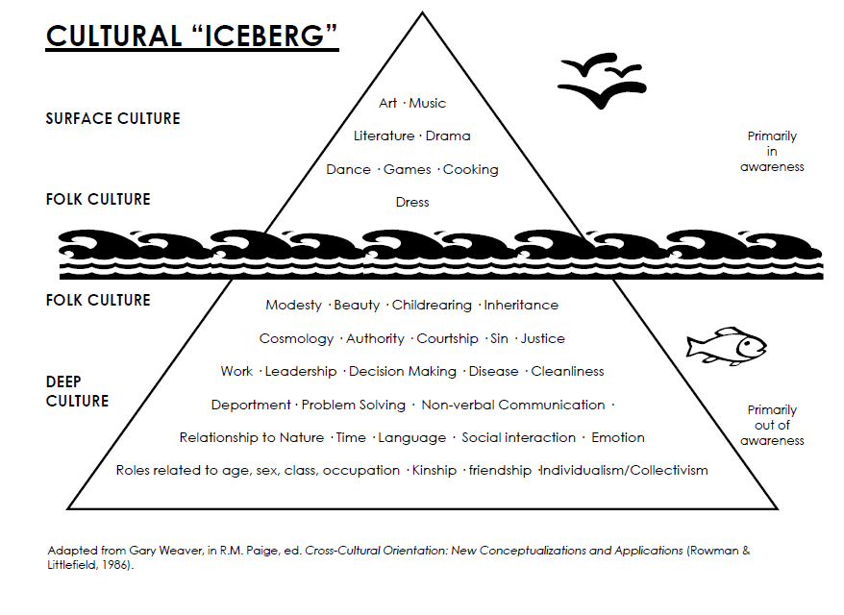

Slide 5
What is Culture?
We only have direct knowledge of our own culture
Our experience with and knowledge of other cultures is limited by the perceptual bias of our own culture
To begin to understand a culture, you need to learn about and understand all the experiences that guide its individual members through life
  Languages
  Gestures
  Religion, philosophy, values
  Food and recreation
  Work and government
  Education and communication systems
  Health, transportation, and government systems
  Economic systems

Slide 6
The Impact of Culture and Cultural Differences
Since we view the world through our own unique cultural lens, our culture impacts everything we do; it regulates every interaction we have with others
  Getting to know elements about your students’ cultures can help you answer the “why” of their behavior
  Learning about and understanding how cultures differ can help you to better equip your students to study and be successful in the United States.
    Types of Cultures
    Cultural Contexts
    Barriers to Communication
    Educational Systems
    Concepts of Freedom

Slide 7
Types of Cultures: Individualist
Individualist cultures:
  Individual interests prevail over group interests
  Have loose ties between individuals; loosely integrated
  Concerned with themselves and immediate families
  Goals set with minimal consideration given to groups other than immediate family
  Define people by their profession, what they have done, their accomplishments, what they drive, where they live
    Materialistic
  Value direct communication

Slide 8
Types of Cultures: Collectivist
Collectivist cultures:
  Interest of the group prevails over interest of the individual
  Establish strong, cohesive groups that last a lifetime; unquestioning loyalty
  Other groups considered in a major way when goals are set
  Tightly integrated
  Define people through relationships (to whom are you related?)
    Stress interdependent activities and suppressing individual’s aims for the group’s welfare
    Family/community-driven
  Value indirect communication

Slide 9
Cultural Contexts
Culture affects our perception based on the cultural context we are in.
  Low context
    Little of meaning is determined by the context because the message is encoded in the explicit, or direct code
    Often individualist societies
    Verbal abilities are highly valued
    Logic and reasoning are expressed in verbal messages
    People have attributes independent of circumstances or of personal relations
      People are free agents who can move from group to group and setting to setting without significant changes.
  High context
    Less has to be said or written because more of the meaning is in the physical environment or already shared by people
    Often collectivist societies
    More sensitive to nonverbal messages
      People are connected, fluid, and conditional
      Participation in relationships makes it possible to act; completely independent behavior usually isn’t possible or even desirable

Slide 10
Concept of Face
Face = confidence of society in the integrity of ego’s moral character, the loss of which makes it impossible to function properly with people in the community
Once can lose face through:
  An overt rejection
  Exposure to personal insult
  Exposure to a derogatory remark or disregard for one’s status
  Being forced to give up a cherished value
  Making what may later be seen as an unnecessary concession
  Failure to achieve goals
  Revelation of personal inadequacy
  Damage to a valued relationship

Slide 11
Concept of Face
  High-context cultures (with greater concern for interdependence and inclusion) tend to be more hierarchical and traditional societies
    Concepts of shame and honor are very important
    Avoid direct confrontation or use communication strategies to maintain harmony and reduce the possibility of conflict
    Communication is more indirect or implicit and is likely to use intermediaries
    Social harmony and face maintenance are crucial; using intermediaries eliminates face-to-face confrontation, reduces risk of losing face
  Low-context cultures (individuals guided more by personal responsibility rather than by shaming one’s group)
    Greater concern for privacy and autonomy
    Tend to use direct-face negotiation and express more self-maintenance

Slide 12
Barriers to Communication
Every culture and subgroup provides its members with rules specifying appropriate and inappropriate behavior
There is no way you could learn all the rules governing appropriate and inappropriate behavior for every culture and subgroup with which you come into contact
What you can do is to examine the barriers to international communication:
    Anxiety
    Assuming similarity
    Ethnocentrism
    Stereotypes and Prejudice
    Nonverbal misinterpretations
    Language

Slide 13
Educational Systems
Deeply held cultural beliefs are reflected in educational systems around the world in terms of:
  Curricular choices (what is taught)
  Teaching styles (how it’s taught)
  Learning environments (student-centered vs. teacher-centered)
  Assessment/evaluation methods (memory recall vs. application of critical thinking skills)
  Learning Skills (memorization vs. construction of knowledge)
  Teacher/Student roles
  Academic writing styles
  Importance of grades vs. importance of knowledge
  Academic freedoms (what they study, when they study)
Students are expected to adapt to the educational environment they find themselves in, even though this may be the opposite of what they have experienced through most of their lives

Slide 14
Concepts of Freedom
As is the case with most students, attending university often results in a brand-new sense of freedom:
  Absence of parents/guardians
  Need for self-regulation and self-reliance
  Freedom of expression
  Freedom of choice
For international students, attending university in the United States can result in an even deeper sense of freedom but not necessarily a greater sense of responsibility

Slide 15
Freedom
International students often struggle to adapt to their new freedoms; they may exercise more freedom or a deeper degree of freedom than is good for them
  Most students find a good balance of freedom and restraint
  When students begin to exhibit an imbalance of freedom and restrain, it might be time to talk to them
If it gets to the level where you feel their academic well-being is in danger, it might be time to talk to parents or guardians
  Students’ behavior can reflect the belief that they are so far away from home that their parents will never know what they are doing
  Parents are often unaware/uninformed of FERPA regulations, how the US educational system operates, and what is expected of their children
    Have a plan to communicate basic information to parents BEFORE classes start
    Have a plan to communicate with parents AFTER classes start
    This often means using a liaison with knowledge of the students’ home language and culture

Slide 16
Freedom
Some international students’ home countries do not have basic freedoms, such as freedom of the press and freedom of speech
  International students may have access to a wider array of print, television, and internet outlets from which to get their news
    If they lack the critical thinking and evaluative skills to effectively sift through the mountains of news stories, they may end up not being able to tell the difference between actual news and fake news or to identify which news agencies present news from different perspectives
  With so many people offering their opinions regarding American politics and issues, international students may feel they have much greater leeway to speak their minds than they should use
    Make sure international students understand the challenges that come with freedom of speech (i.e., free speech vs. hate speech)
    Inform them that freedom of speech often has unintended consequences, especially for non-immigrant students and foreign visitors
      Examples

Slide 17
Responding to the Country’s Current Political Climate
The future of international students in the United States may seem tenuous
  Discussion of changes in visa procedures and travel bans may begin to concern international students
  America’s reputation in the world may not seem as solid as it has in the past
  Recent, highly publicized gun violence incidents may make students from gun-free countries feel unsafe
  Weekly protests may need to be explained in non-biased terms so students understand what is happening

Slide 18
Getting and Retaining International Students in American Universities
How do we make sure international students keep enrolling and attending our institutions?
  Create efforts to prepare students for study in the United States (not just academically, but socially as well)
  Make sure someone at your university is keeping abreast of policy changes that might affect international students, and that your students are made aware of policy changes
  Keep in regular contact with your students
  Create a “safe space” where students are free to speak openly about issues that concern them; encourage students to come talk to you if they hear something that worries them
  Do your best to help students feel safe, protected, and valued

Slide 19
Final Thoughts
Our international students are not just any other students
  They are facing unique challenges every day; these challenges may transcend the academic arena
  Understanding how cultures differ may help you anticipate what information might be useful to help prepare international students for their studies
  Taking a deeper look into your students’ home cultures can provide some valuable insights into what issues they might face at an American university

Slide 20
Questions?

