Slide 1
Interpersonal Communications in the Workplace
Carlier Myers
Associate Registrar

Slide 2
Interpersonal Communication
What is Interpersonal Communication?
Communication is interpersonal when it involves two or more people taking turns speaking and listening.
To communicate effectively, in other words, to be understood and understand others, is a set of skills to be learned and practiced.
Exchange of thoughts and ideas between individuals.
Verbal and nonverbal – tonal variation, facial expression, gestures, body language.
In person and through email, other digital means of communication.
“When interpersonal communication in the workplace is effective, it makes operations more efficient and teamwork not only possible but easier”. ¹
¹The Effects Of Interpersonal Communication in an Organization Nicky LaMarco - https://smallbusiness.chron.com/effects-interpersonal-communication-organization-18338.html

Slide 3
Components of Interpersonal Skills
Ability to manage conflict
Problem solving/negotiation
Communication
Listening
Flexibility
Showing appreciation
Being accountable for actions
Demonstrating responsibility
Emotional intelligence

Slide 4
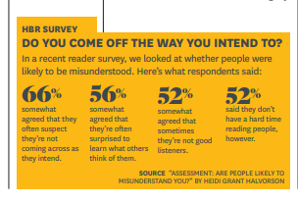
Common misconceptions about communication
“If I say it, the other person will understand.”
Not necessarily. Meaning is determined by the receiver of the message, so just saying it doesn’t mean it will be understood. Need to check in with the person to see if the meaning of your message is understood as intended.
“The more communication, the better.”
Not necessarily. Talking too much and louder is a mistake. Excessive talking won’t help and can actually make the situation worse. Try other ways of expressing yourself. Knowing when to remain silent is a part of communicating effectively.
“Any problem can be solved at any time if we communicate with each other.”
There are times when taking some time away from each other can be a better solution than talking it out. Intensive emotions such as anger or sadness can blow an interaction out of proportion. A few moments of self-reflection can help gain perspective on the issue.
“Communication is a natural ability - some have it, some don’t.”
False. Skillful communication can be learned with practice. There are some simple techniques that improve how you understand and how others understand you.
Do You Come off the Way You Intend To? Harvard Business Review. 2015;93(9):22. http://search.ebscohost.com/login.aspx?direct=true&AuthType=ip,shib&db=bth&AN=109053049&site=ehost-live. Accessed July 11, 2019.

Slide 5
How to Improve Interpersonal Communication in the Workplace
Research and Plan
Gather the facts. Use facts to keep the discussion neutral.
Understanding your audience
Try to put yourself in their shoes to understand their point of view and how they might receive your words.
Self-evaluation
Checking your self – emotions, tone, using “I” sentences.
Checking for understanding – “So, it sounds to me” or “What I am hearing you say…”
Use an “open tone”

Slide 6
How to Improve Interpersonal Communication in the Workplace
Monitor Expectations
Cannot control or change anyone.
Everyone is responsible for their own actions.
Determine desired “win-win” outcome
May require compromise and still be “win-win”.
Actively listen as much as you speak
Practice the conversation

Slide 7
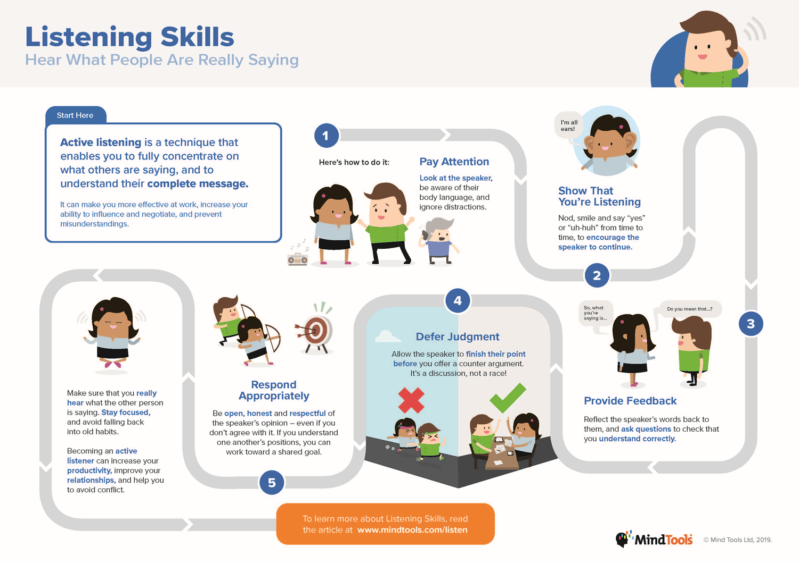

Slide 8
Scenario 1
Recently, you and three or four other members of your group have been increasingly aware of personal disagreements and unspoken resentments among the people with whom you work. There is no official procedure to handle such problems, and you realize that, not only is productivity (personal and collective) suffering, but that everyone appears to be unhappy in general with the declining working conditions these problems have created. You feel the same way and would like to do something to improve the situation.
Considering the fact that these three or four other individuals are also aware of the problem, what can you do?

Slide 9
Scenario 2
A fellow employee, Phil, has not been contributing equally to complete the normal weekly work at hand. Phil claims he is contributing, but that he is swamped with other work and the emotional aftermath of a bitter divorce. Some fellow workers are upset that he has been so lax and feel that they should take their complaints about Phil to the supervisor. You are good friends with Phil and know he's not lazy but feel that he may be overdramatizing his problems a bit. Your brought up the topic with Phil over coffee last night, but he was defensive and maintained his "innocence" he even accused you of not sympathizing with him.
What alternatives are there to the course of action your fellow employees want to take (filing a complaint with the supervisor)?
How might your suggestions improve the situation without involving the administration or hurting Phil's professional reputation?

Slide 10
Questions? Contact: Carlier Myers cmyers@case.edu

