Slide 1


Information Security in Your Office
Bob Bulow
Ohio University
ohio.edu/registrar

Slide 2

Overview
Introduction
Being More Secure
  Partnering with IT
  What You Can Do
Wrap Up

Slide 3
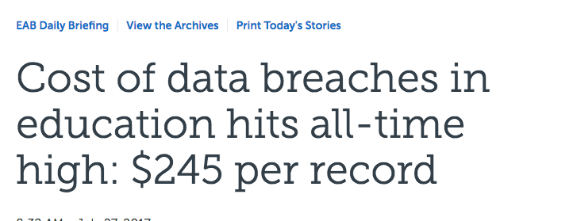
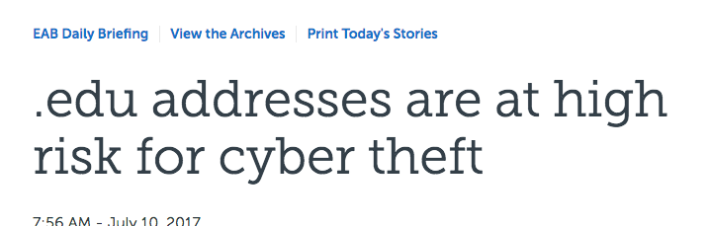
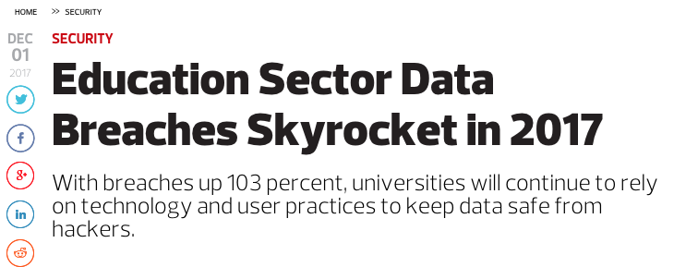

Slide 4
Self Assessment
On a scale of 1 to 10, how good are you at being secure?
Why did you rate yourself this way?
What are some things you do (or don’t do) that influence your decision?

Slide 5
Ranking Security Practices
Ranking Activity

Slide 6
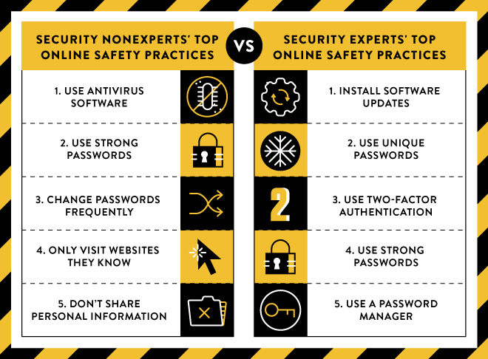
https://security.googleblog.com/2015/07/new-research-comparing-how-security.html

Slide 7

Being More Secure
Key
  * Things to do personally and professionally
  # Things to do without technology (i.e., behavioral things)

Slide 8
Partnering with IT
Data Storage
  File encryption
  Disk encryption
  Share files securely
  Automated backups
*Software patches applied
Password policies
*Dual- or two-factor authentication
Data security policies

Slide 9
Partnering with IT
#Create a climate where staff think about data security
#Training and awareness
Lockout limit based on failed attempts
*Wipe computers before recycling
*VPNs
*Desktop security management (i.e., admin access)

Slide 10
What You Can Do
*#Create awareness
#Policy for data retention and data disposal
*Do not click on suspect links and attachments
  How to inspect a link
  Dangerous types of attachments
*Do not send sensitive data via email (and delete it if someone sends it to you)
*Lock your computer when you walk away
*#Lock physical files

Slide 11
What You Can Do
*#Have strong passwords & change if needed
  If you use the same password for multiple things
  If your account might have been hacked
  What is a strong password?
*Use a password manager, e.g. LastPass, 1Password
Limit who has access to data in system
#Third party contracts have responsibility for data handling

Slide 12
What You Can Do
#Collect data only if needed
*#Provide data only if necessary
*#Eliminate use of SSN
Limit who can access SSN, Date of Birth
Do not use (or limit) who can have student data on portable drives
#Employee acknowledge responsibilities

Slide 13
What You Can Do
*Back up files routinely (if it is not automated by IT)
*Limit who has access to the files
*Password-protect files
*Personal device security (laptops, phones, tablets)
*Wireless network security

Slide 14
What You Can Do
*Virus/malware protection software and run regular scans
*Avoid downloads
*Use secure connections to Internet (https)
#Keep office doors locked

Slide 15
What You Can Do
#Privacy screen protectors
Routinely review who has access to data
#Clean desk club
#Internal audit conduct a review

Slide 16
Wrap Up and Questions
“…no one can hack my mind”
  Use tools where it makes sense
Personal and professional are more intertwined than ever before
  Personal life (in regard to accounts, security, etc.) can impact professional life and vice versa
Doing something is better than doing nothing
  Try at least one new thing from the suggestions

Slide 17

Resources
EDUCAUSE – Higher Education Information Security Guide
https://spaces.at.internet2.edu/display/2014infosecurityguide/Home
EAB – Information Security
https://www.eab.com/topics/information-technology/information-security
Google Security Blog Post
https://security.googleblog.com/2015/07/new-research-comparing-how-security.html
Have I Been Pwned?
https://haveibeenpwned.com/

Slide 18

Bob Bulow
Associate Registrar for Technology and Communication
bulow@ohio.edu
740.593.2469

